Slide 1
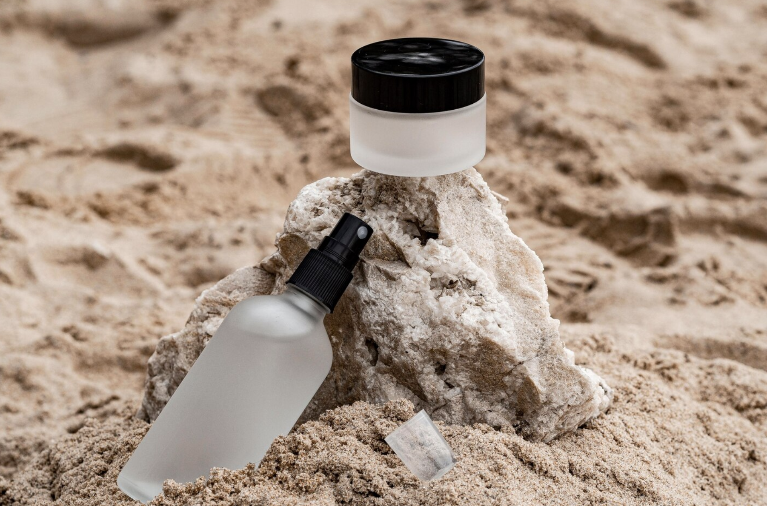
Supervised Learning: Skincare Recommender
Based on Consumer Sentiment and Popularity

Slide 2
Overview
Goal: Build skincare product recommendation system that evaluates sentiment across product reviews and predicts recommendation likelihood and popularity
Natural Language Processing and Supervised Machine Learning
Sentiment analysis - Pretrained transformer RoBERTa
Recommendation target - Combined is_recommended and sentiment to build a clean binary target for classification model
Models:
Classification models: Logistic Regression, Random Forest, and XGBoost
Regression models: Ridge, Random Forest, and XGBoost

Slide 3
Data Preprocessing
Dataset used:
https://www.kaggle.com/datasets/melissamonfared/sephora-skincare-reviews
Sentiment Analysis
Cardiff NLP model to analyze the sentiments across reviews
Create Ranking System
Build a composite scoring function using PCA (Principal Component Analysis):
rating (user-based)
avg_sentiment_score (RoBERTa-based)
review_volume (number of reviews)
price_usd (product price)
Merge review and product metadata

Slide 4
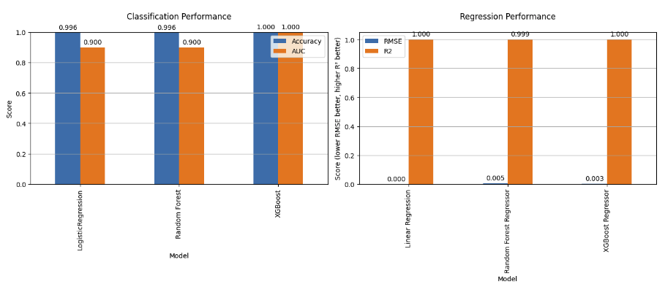
Regression and Classification Model Testing Using Single Train-Test Split

Slide 5
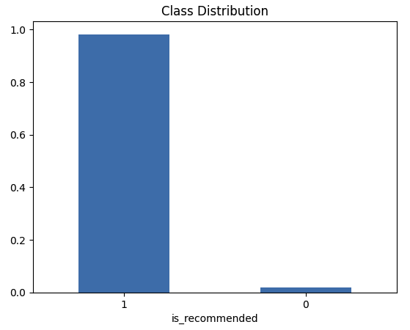
Overfitting Issue
XGBoost - Overfitting due to class imbalance
Create a clean proxy label that combines is_recommended and sentiment
Apply SMOTE to synthetically balance the minority class

Slide 6
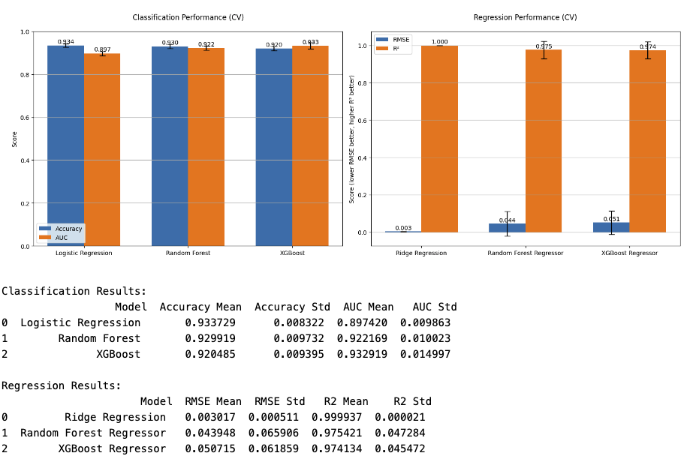
Cross-Validation with SMOTE Pipeline (StratifiedKFold)

Slide 7
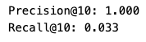
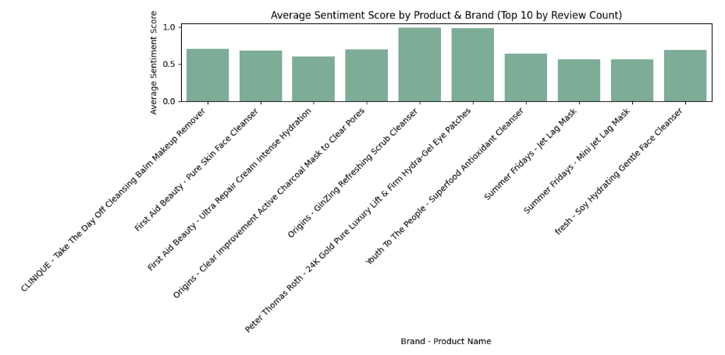
Model Evaluation and Visualization
Model is highly precise, everything it recommended was spot-on
The model only retrieved 3.3% of the relevant products, which isn't covering much ground
Future recommendation: consider improving recall through model tuning or ensemble techniques

Slide 8
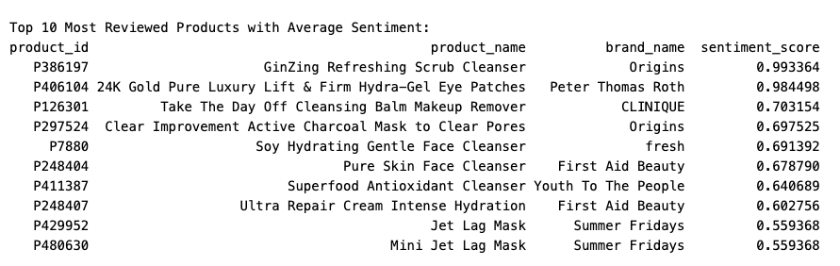
Model Evaluation and Visualization

Slide 9
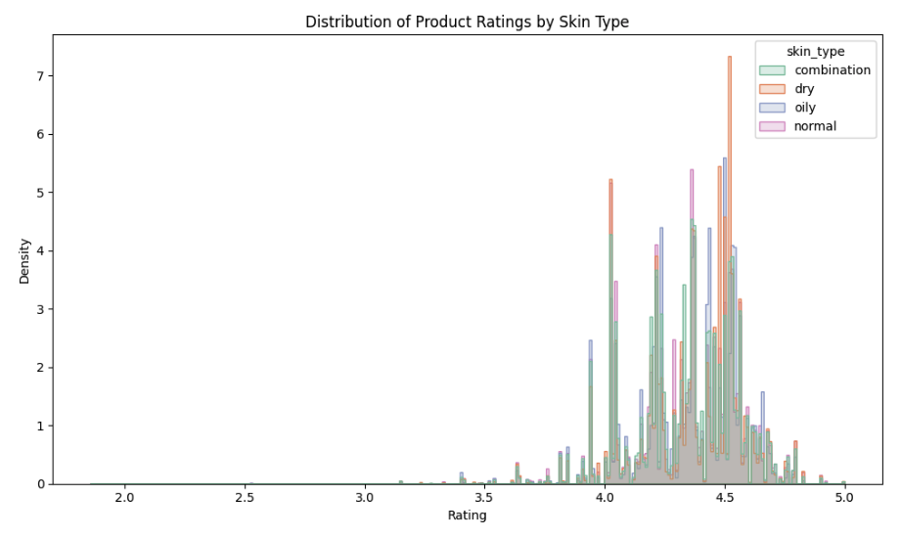
Model Evaluation and Visualization

Slide 10
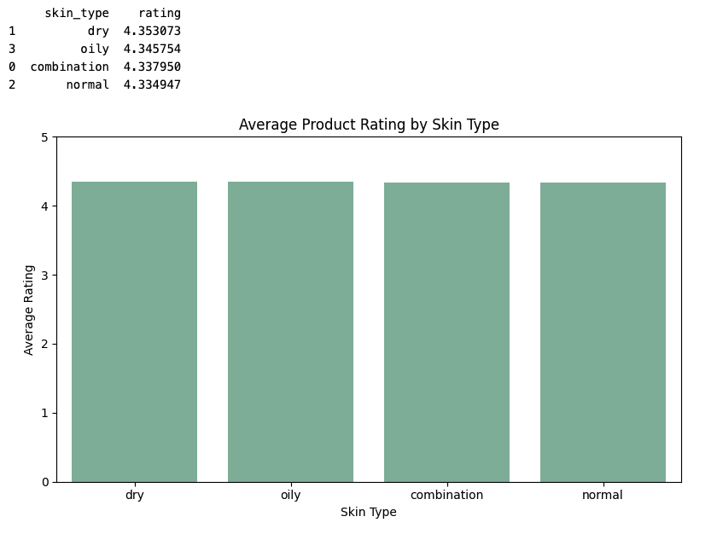
Model Evaluation and Visualization

Slide 11
Conclusion
XGBoost came on top for recommendation classification while Random Forest for predicting popularity
For future recommendations, it could be further enhanced by integrating deeper NLP on product highlight

